Slide 1
Software Architecture & Design Lecture 03: Architectural Structures and Views
Sarmistha Sarna Gomasta

Slide 2
Lesson Objectives
To understand Software architectural Structures and Views
To know about different types of structure

Slide 3
Lesson Outcomes
End of this lesson students will
get an overview of Software Architectural Structures and Views
Can able to understand different types of structure and views

Slide 4
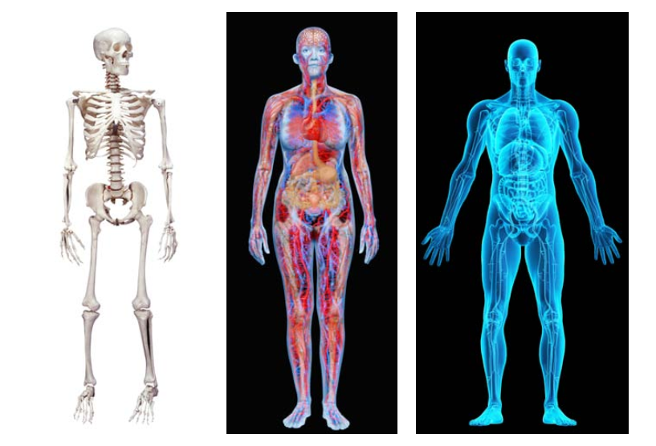
Architectural Structures
Figure 01: Physiological structures

Slide 5
Architectural Structures (cont.)
One body has many structures.
Different stakeholders are interested in different structures.
Modern software systems are too complex to grasp all at once. At any moment, we restrict our attention to a small number of a software system’s structures.
To communicate meaningfully about an architecture, we must make it clear which structure or structures we are discussing.

Slide 6
Architectural Structures and Views
We will be using the related terms structure and view when discussing architecture representation.
A view is a representation of a coherent set of architectural elements, as written by and read by system stakeholders. It consists of a representation of a set of elements and the relations among them.
A structure is the set of elements itself, as they exist in software or hardware.

Slide 7
Structures and Views (cont.)
In short, a view is a representation of a structure.
For example-
a module structure is the set of the system’s modules and their organization.
A module view is the representation of that structure, documented according to a template in a chosen notation, and used by some system stakeholders.
So we can say- Architects design structures. They document views of those structures.

Slide 8
Architectural Structures Types
Architectural structures for software systems can be divided into three types:
Module structures – consisting of elements that are units of implementation called modules and the relationships among them
Component-and-Connector structures – consisting of run time components (units of computation) and the connectors(communication paths) between them
Allocation structures – consisting of software elements and their relationships to elements in external environments in which the software is created and executed

Slide 9
Structures Types(cont.)
Architectural structures for software systems can be divided into three types:
Module structures
How the system is to be structured as a set of code or data units?
Component-and-Connector structures –
How the system is to be structured as a set of elements that have runtime behavior (components) and interactions (connectors).
Allocation structures –
how the system will relate to nonsoftware structures in its environment (such as CPUs, file systems, networks, development teams, etc.)

Slide 10
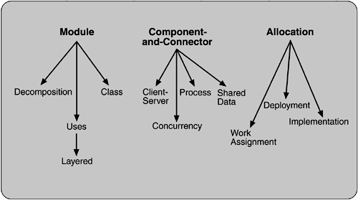
Architectural Structures Types
Figure 02: Three Architectural Structures Types

Slide 11
Structures Types- Module
Elements are modules, which are units of implementation. * What is the primary functional responsibility assigned to each module? * What other software elements is a module allowed to use? * What other software does it actually use?

Slide 12
Module Structures
Decomposition * shows how larger modules are decomposed into smaller ones recursively
Uses * The units are: modules, procedures or resources on the interfaces of modules * The units are related by the uses relation
Layered * "uses relations" structured into layers
Class, or generalization * shows the “inherits-from” or “is-an-instance-of” relations among the modules

Slide 13
Structures Types- Component-and-connector
Elements are runtime components (units of computation) and connectors (communication vehicles among components) The relation is attachment, showing how the components and connectors are hooked together * What are the major executing components and how do they interact? * What are the major shared data stores? * Which parts of the system are replicated? * How does data progress through the system? * What parts of the system can run in parallel? * How can the system’s structure change as it executes?

Slide 14
Component-and-connector Structure
Process, or communicating processes
units are processes or threads that are connected with each other by communication, synchronization, and/or exclusion operations
Concurrency
The units are components and the connectors are “logical threads”. A logical thread is a sequence of computation that can be allocated to a separate physical thread
Shared data, or repository
This structure comprises components and connectors that create, store, and access persistent data
Client-server
The components are the clients and servers, and the connectors are protocols and messages

Slide 15
Structures Types- Allocation
The relationship between the software elements and the elements in one or more external environments * What processor does each software element execute on? * In what files is each element stored during development, testing, and system building? * What is the assignment of software elements to development teams?

Slide 16
Allocation structures
Deployment
Shows how software (usually a process from a component-and-connector view) is assigned to hardware-processing and communication elements
Relations are “allocated-to” and “migrates-to” if the allocation is dynamic
Implementation
How software elements (usually modules) are mapped to the file structure(s)
Work assignment
Assigns responsibility for implementing and integrating the modules to development teams

Slide 17
Thanks

